Slide 1

Parent Information Session
2026-2027
Years 5 and 6

Slide 2
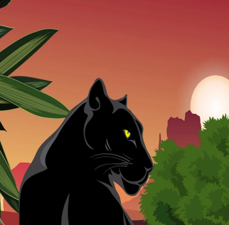
Panther Class
Miss Elliott
Mrs Edwards
Mrs Williams

Slide 3

Puma Class
Mrs Spilsbury
Mrs Shelley

Slide 4

Jaguar Class
Mrs Kelly & Mrs Byfield
Mrs Reaney

Slide 5



Hawley Values
Respect, Resilience, Creativity
Learning for Life

Slide 6
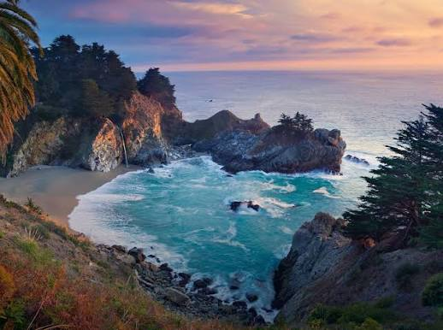
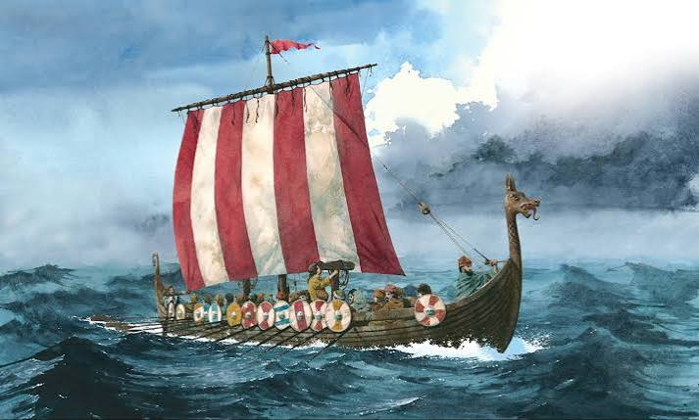
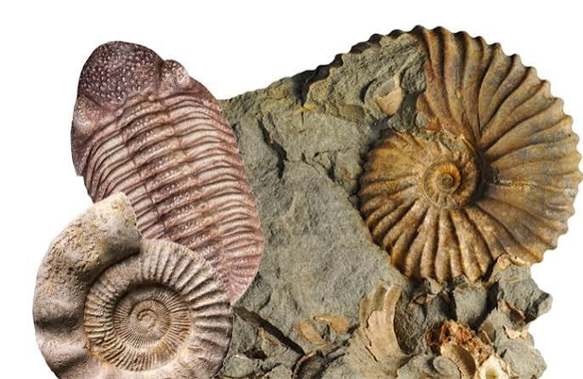
Curriculum
Autumn 1 – Coastal Adventures
Autumn 2 – Sensational Shang
Spring 1 & 2 – We Rule! (Anglo Saxons and Vikings)
Summer 1 & 2- Ever Evolving

Slide 7
Maths
Fibonacci – Mrs Kelly/Mrs Byfield and Mrs Shelley
Pythagoras – Mrs Spilsbury and Mrs Reaney
Nightingale – Miss Elliott, Mrs Edwards and Mrs Williams

Slide 8
Trips
Year 5/6 – Lepe Beach– 28th September 2026
Year 5 – Runways End – 4th November – 6th November 2026
KS2 – PANTO – 15th December 2026
Year 5/6 Anglo Saxon & Viking Workshop – 12th February 2027
Y6 – Activity Week – 5th July – 9th July 2027

Slide 9





Homework
5 reads a week minimum
20 minutes per week (5 mins a day for 4 days etc)
Practise spelling at home
Year 6s will be given SATS Question Books for their homework over Christmas and in the lead up to SATS.
SATS Revision books are available to purchase from Mrs Lody later in the year.

Slide 10
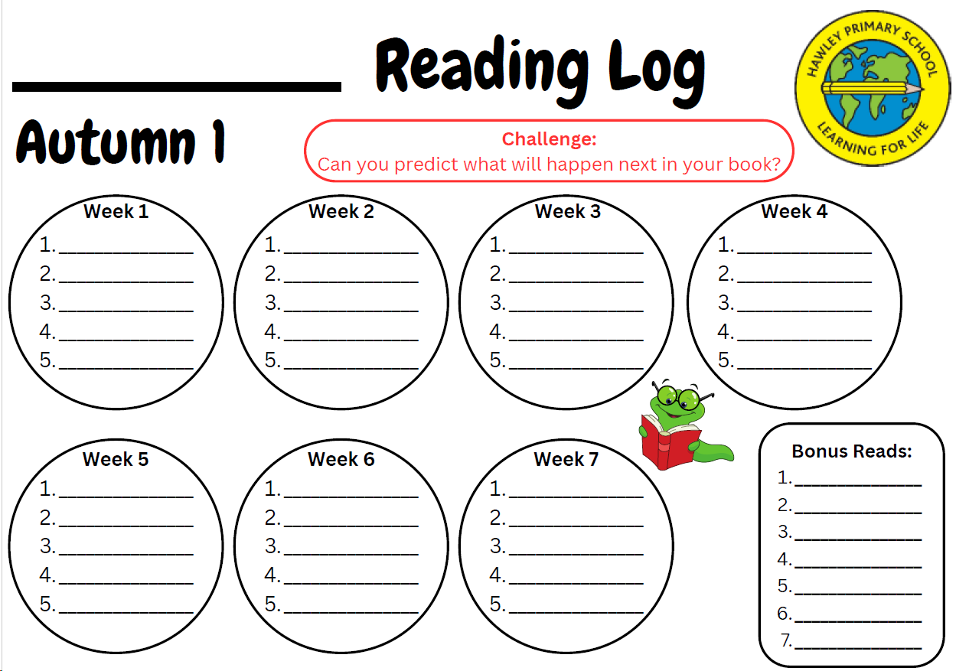

Slide 11
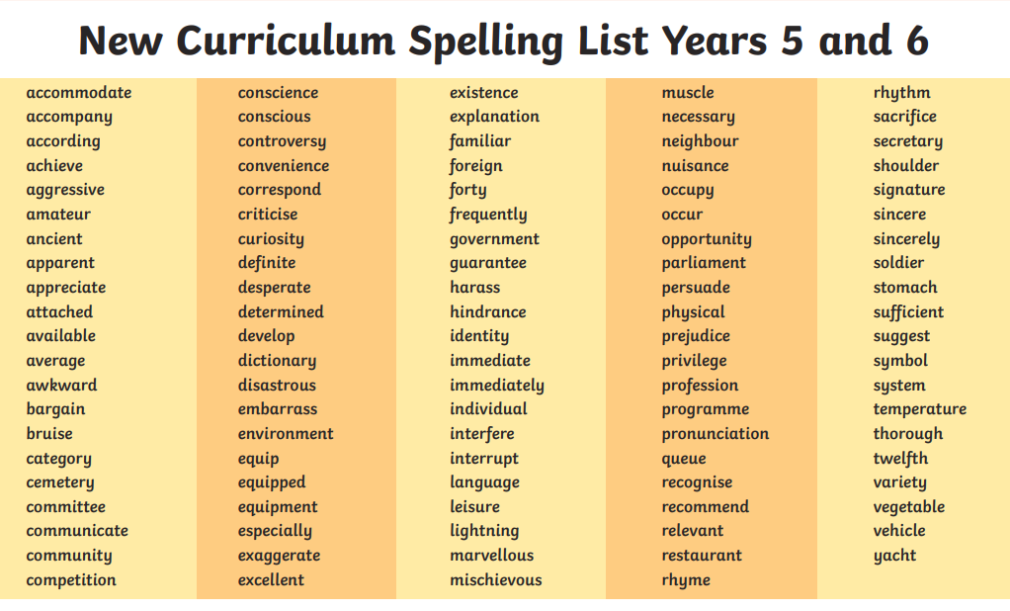



Spellings
Alongside in-school practice, the children are expected to practise their spellings at home at least 3 times a week. ​
They are required to learn and remember their spellings to confidently use in their writing.

Slide 12

Seesaw
Seesaw
Seesaw is a journal of your child’s learning.
Seesaw is a learning tool used to support our learning in KS2 (including photos, pieces of work, voice recordings etc.)
Communication via Seesaw should be non-urgent as this is not checked regularly throughout the school day. Any urgent messages should be communicated with Mrs Lody.

Slide 13
Handwriting
Regular handwriting sessions take place in class. Children are expected to use joined handwriting.
No pen licences – children will be given the option to write with a pen if they are writing neatly. We encourage them to choose depending on the task and purpose.
SATs/End of Key Stage 2 Assessment

Slide 14


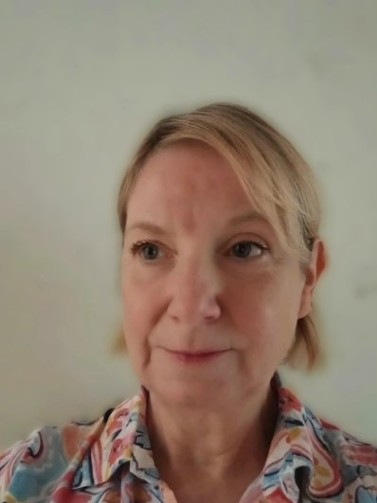





FRENCH
Autumn 1 – All about the Weather and Season
Autumn 2 – All about Clothes
Spring 1 – All about Food
Spring 2 – All about Directions
Summer 1 – All about Time
Summer 2 - Putting it all together
Rhinos : Monday
Elephants : Tuesday
Gorillas : Wednesday
Puma class : Monday
Jaguar class : Monday
Panther class : Tuesday
Mme Wos
How can you help?
Encourage your child to play the games posted on Seesaw (repetition is key to language learning)
Links to songs and videos played in the classroom will be posted on Seesaw

Slide 15
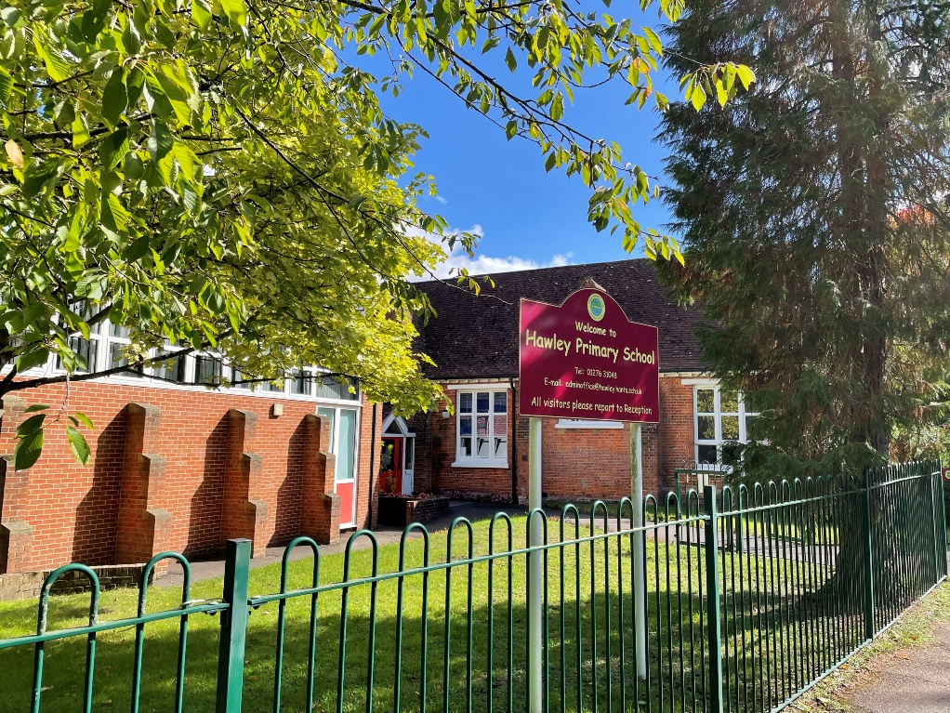
The School Day
08.15 – Gates open for KS2
08.30 – Register closes for KS2 and lessons begin
08.30-10.30 – Lessons
10.30-10.45 – Break time
10.45-12:15 – Lessons
12.15-13.00 – Lunch time
13.00 – Afternoon Registration
13.00-14.30 – Lessons
14.30-14.45 – Assembly
15.00 – Home Time

Slide 16
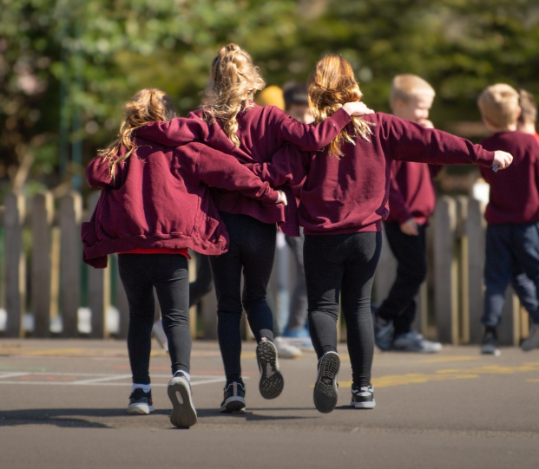
Upper KS2:High Expectations
The School Day
Behaviour: we follow the golden rules. For every golden rule broken, the children will stay in for their age in minutes.
Responsibility for their equipment: children must bring in their reading books and reading log every day.
Tuck shop money is your child’s responsibility and must stay in their lockers until breaktime.
Take initiative for home tasks – we expect the children to read, practise spellings and do TTR at home independently.
Resilience: we know that the work will be harder and that mistakes will be made but we always try our best.

Slide 17

Our Rewards
Our Rewards
Staff will award children with house points for their learning.
Staff will award children with dojo points for their behaviour.
Once a class reaches 1,000 dojos, they will earn a whole class reward.

Slide 18
School Uniform
All children are required to wear:
Burgundy crew neck sweatshirt or cardigan with the embroidered school logo.
White shirt, polo shirt or blouse
Grey shorts, trousers, skirt, pinafore dress or burgundy/red and white striped/checked dress in the summer months
Grey, white, burgundy socks or tights
PE kit
Black shorts
House Team T-shirt – available to purchase from the school in the appropriate House team colour
Black plimsolls/trainers
Trainers for outdoor PE sessions
Black jogging trousers or leggings for outdoor, winter sports activities
Footwear
All children should wear black school shoes with flat heals (no boots)
Jewellery
No jewellery is permitted. If your child has their ears pierced, they should wear a single stud (plain gold or silver only). These need to be either taken out or covered by tape for PE for safety precautions.
Digital or smart watches are permitted if they DO NOT include a photographic function.
Hair
All children should wear their hair up, if it is longer than shoulder length. No extreme haircuts/styles are permitted (no tram lines, patterns or coloured hair), children should not wear excessive hair accessories.
Calls will be made to remove/bring in incorrect uniform.

Slide 19


We are now smartphone free

Slide 20
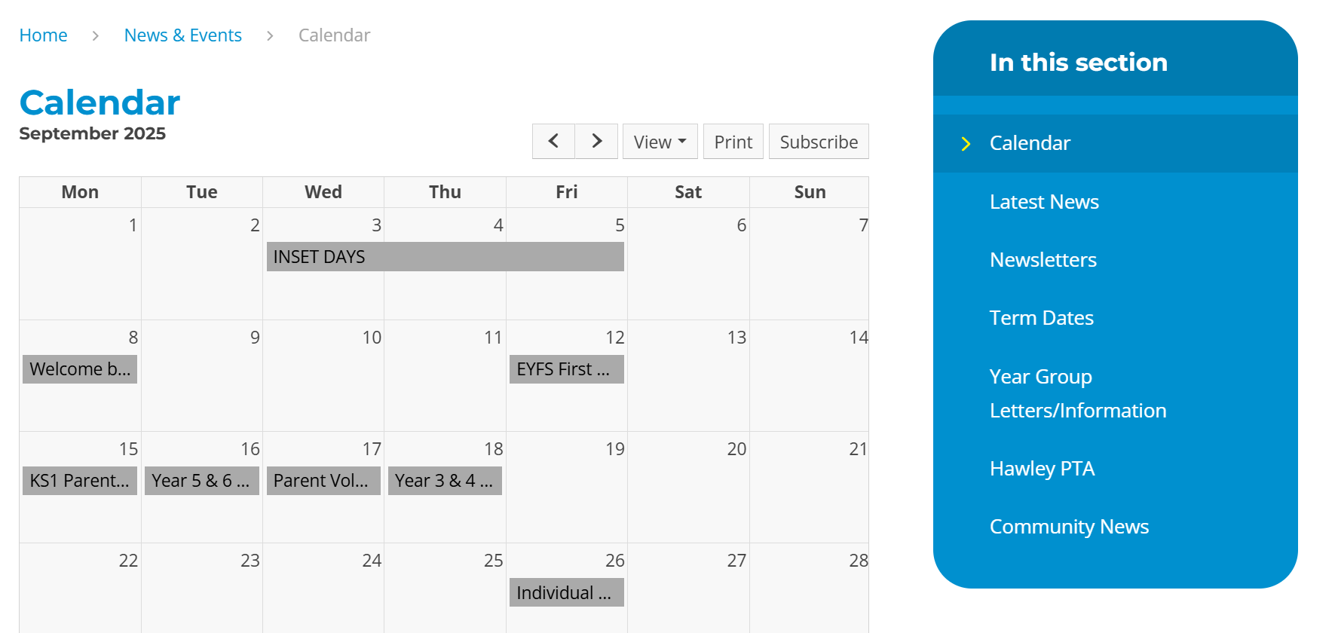
Key Dates
Key dates are published on the calendar our school website:
https://www.hawleyprimary.co.uk/calendar/?calid=1&pid=3&viewid=1

Slide 21
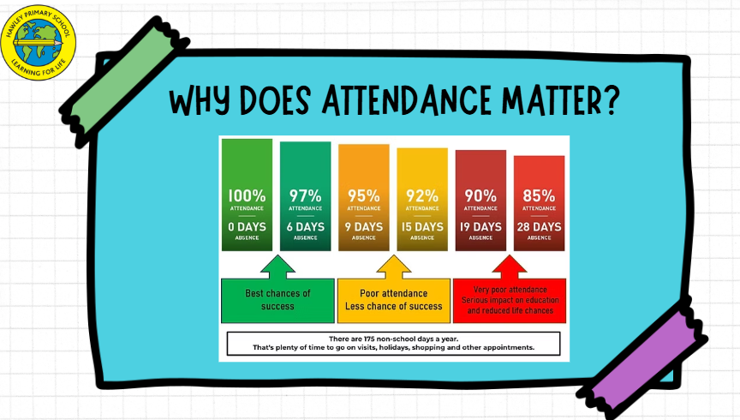
Attendance

Slide 22
How can you help?
Encouragement, support and positivity.
Praise effort, resilience and learning attitude as well as the finished product.
Communication with us – please contact your child's teacher
Supporting learning at home.
Tissues for the classroom.
Be active on Seesaw.
Encourage independence.

Slide 23
Year 5 and 6
Any questions?

