Slide 1

Key Stage 2 SATs
A School Presentation to Parents 2026 – 2027
Notes:
Hayley

Slide 2

What are end of key stage two assessments?
SATs (Standard Attainment Tests), are national curriculum tests
that are taken by children at the end of key stage two.
All children (unless exempt) are assessed via SATs during the last term of year 6; for 2027, this is in the week beginning 10th May
The aim of the tests is to establish whether pupils are working at an expected level in English and Maths for the end of primary school and the start of secondary school.
Pupils sit six different tests in three subject areas: Maths, English reading and English grammar, spelling and punctuation.
Writing judgements are made by the pupils’ teachers through teacher assessment, based on evidence of independent writing gathered over the course of year 6.
Notes:
Hayley

Slide 3
When will SATs be held at Hawley?
Every primary school across the country will test their pupils on the same subject at the same time during the week beginning 10th May 2027
The schedule of tests for this year looks like this:
Assessment week 2027 | Tests
Monday 10th May | English grammar, punctuation and spelling Paper 1: questions Paper 2: spelling
Tuesday 11th May | English reading
Wednesday 12th May | Mathematics Paper 1: arithmetic Paper 2: reasoning
Thursday 13th May | Mathematics Paper 3: reasoning
Notes:
Hayley

Slide 4
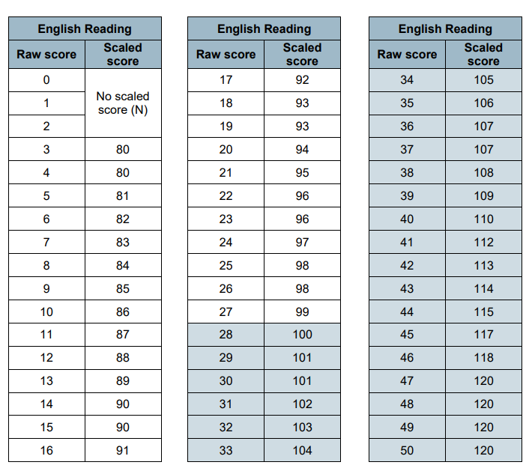
Assessment and Reporting-Scaled Scores
What is meant by ‘scaled scores’?
Range of scores: 80 to 120
Attaining 100 will always represent the ‘national standard’.
Each pupil’s raw test score will therefore be converted into a score on the scale, either at, above or below 100.
Using the scaled score, the lowest a child can score is 80, with the highest being 120.
A child who achieves the ‘national standard’ (a score of 100) will be judged to have demonstrated sufficient knowledge in the areas assessed by the tests.
Notes:
Becca

Slide 5
Scaled Scores
A child awarded a scaled score of 100 - 109 is judged to have met the ‘national standard’ in the area judged by the test and are performing at the expected standard for their age.
If a child’s score is between 110-120, they are working at a greater depth level (above the expected national standard).
If a child’s score is between 80 and 99, they are judged to have not yet met the national standard for their age and are working towards for their year group’s national standard.
Schools do not know what the raw pass mark will be until the results have been published. It alters every year depending upon the country as a whole.
Notes:
Becca

Slide 6
Access Arrangements
There will be some children who need support in accessing the papers.
If a pupil qualifies, they may have the following access arrangements:
25% extra time to complete the paper.
A reader to help access the questions.
A scribe.
Adult support prompt.
Testing completed in a different room.
Access arrangements neither advantage nor disadvantage a pupil. They merely allow them to access the paper provided.
Notes:
Hayley

Slide 7
The Tests
Test | Details
English Grammar, Punctuation and Spelling | Paper 1: questions (45 minutes) 50 marks A combined question and answer booklet which assesses pupils’ understanding of the grammar, punctuation and spelling elements of the national curriculum English programmes of study for key stage two. Paper 2: spelling (15 minutes but not strictly timed) 20 marks The paper that pupils receive has 20 sentences, each with a missing word. The teacher reads the sentences one at a time and pupils write in the missing word on their paper.
English Reading | (1 hour) 50 marks Pupils will have a reading booklet with three different texts to read and a corresponding question and answer booklet. The texts are presented in increasing levels of difficulty and pupils’ comprehension skills will be assessed against the comprehension elements of the English programme of study for key stage two.
Notes:
Bethany

Slide 8
The Tests - Continued
Test | Details
Maths | Paper 1: arithmetic (30 minutes) 40 marks Pupils will have a booklet of arithmetic questions based on the national curriculum maths key stage two programmes of study. Papers 2 and 3: reasoning (40 minutes each) 35 marks each Both papers will ask children to reason and solve problems, again based on the national curriculum maths programmes of study.
Please note: The first time teachers see the papers is the exact same time the children do. We do not know the specific questions on the paper.
Notes:
Bethany

Slide 9
The Reading Paper
The reading test consists of a single test paper with three unrelated reading texts. Children are given 60 minutes in total, which includes reading the texts and answering the questions.
A total of 50 marks are available.
Questions are designed to assess the comprehension and understanding of a child’s reading.
During the reading paper, a child will be testing on the following skills: Retrieval, Inference, Summarising, Word Meaning, Decoding, Predicting, Comparing, Language Choice.
Some questions are multiple choice or selected response; others require short answers and some require an extended response or explanation using evidence from the text they have read.
Notes:
Bethany

Slide 10
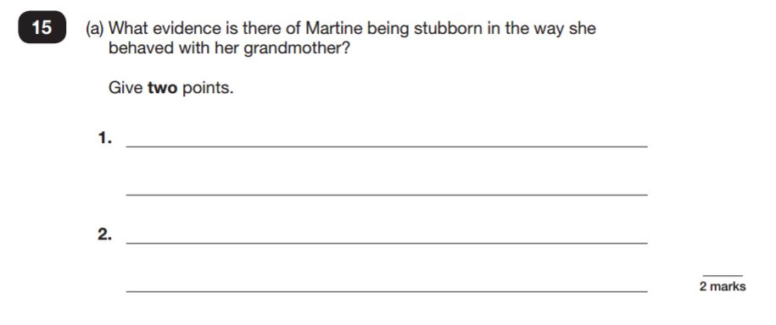
Sample Questions - Reading
Notes:
Bethany

Slide 11
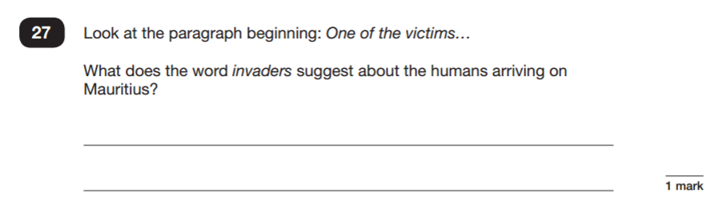
Sample Questions - Reading
Notes:
Bethany

Slide 12
The Spelling, Punctuation and Grammar Papers
A spelling test is administered containing 20 words, which lasts approximately 15 minutes.
A separate test is given on grammar, punctuation and vocabulary.
This test lasts for 45 minutes and requires short answer questions including some multiple choice.
Marks for these two tests are added together to give a total for grammar, punctuation and spelling.
Notes:
Becca

Slide 13
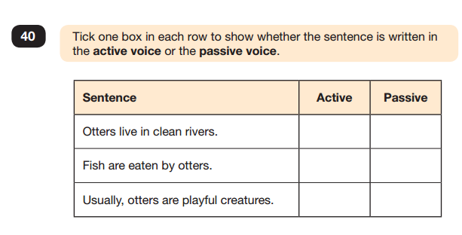
Sample Questions - SPaG
Notes:
Becca

Slide 14
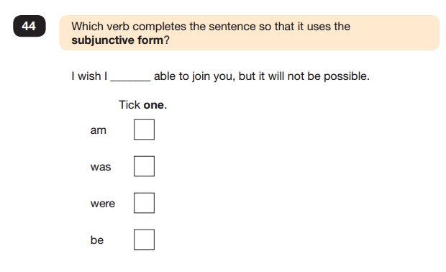
Sample Questions - SPaG
Notes:
Becca

Slide 15
The Maths Papers
Children will sit three tests: paper 1, paper 2 and paper 3.
Paper 1 is for arithmetic lasting for 30 minutes, covering calculation methods for all operations, including use of fractions, percentages and decimals.
Papers 2 and 3 cover problem solving and reasoning, each lasting for 40 minutes.
The scores for each paper are combined to produce a final Maths score.
Notes:
Becca

Slide 16
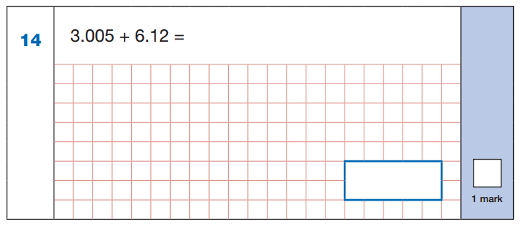
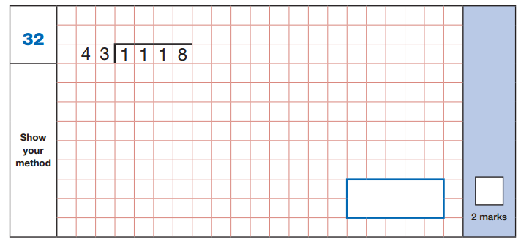
Sample Questions - Arithmetic
Notes:
Becca

Slide 17
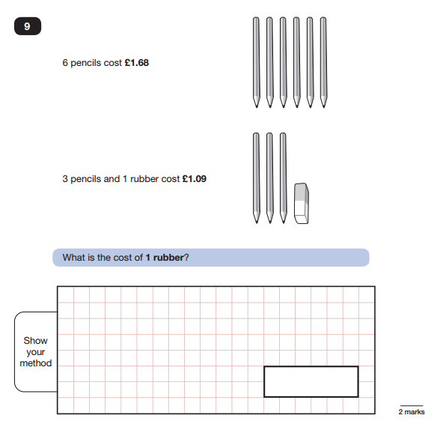
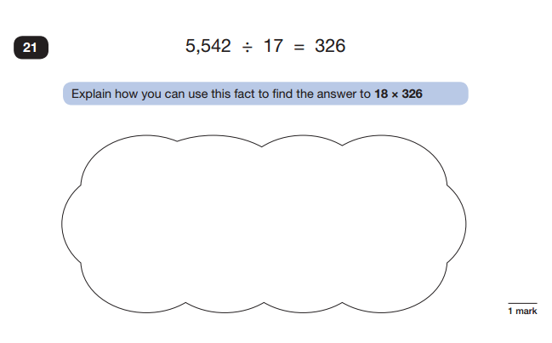
Sample Questions - Reasoning
Notes:
Becca

Slide 18
Year 6 Writing
There is not a writing paper for Year 6. Instead the children complete independent pieces of writing throughout the whole year.
Towards the end of the year (after SATs), the teachers will select the children’s six best pieces of work and assess them.
Notes:
Hayley

Slide 19
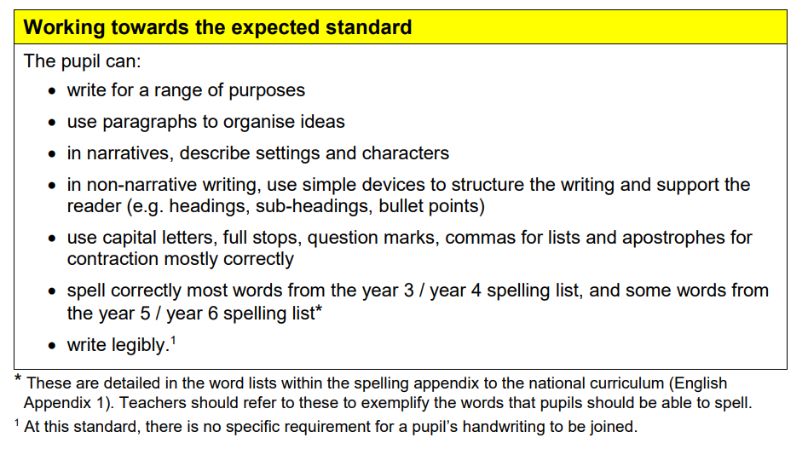
Assessing Year 6 Writing
Notes:
Hayley

Slide 20
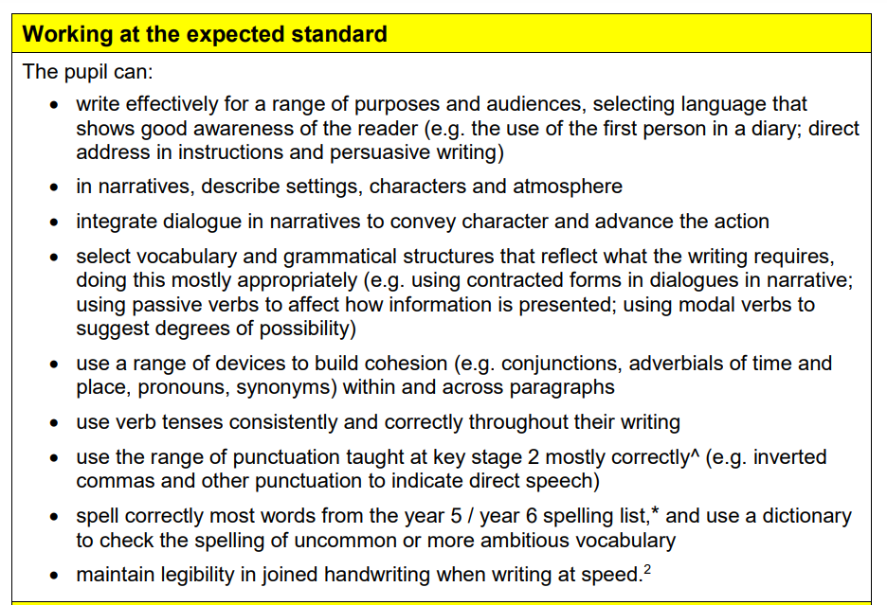
Assessing Year 6 Writing
Pupils must be able to do everything from the working towards list in order to achieve these targets.
Notes:
Hayley

Slide 21
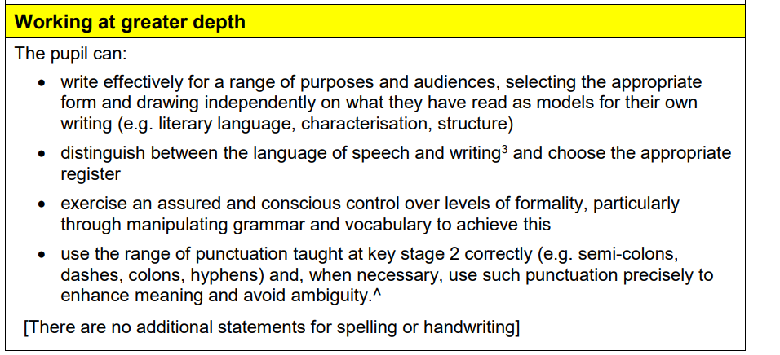
Assessing Year 6 Writing
Pupils must be able to do everything from the working towards list and the expected standard list in order to achieve these targets.
Notes:
Hayley

Slide 22
How can parents support their children?
First and foremost, support and reassure your child that there is nothing to worry about and they should always just try their best. Praise and encourage!
Ensure your child has the best possible attendance at school. If they are late or they are not here, they will miss key learning opportunities!
Support your child with any homework tasks. Questions from the SATs revision guides will be set weekly. The children must complete these as we base lessons on them.
Purchase SATs revision books.
Homework CGP books given for free. They will receive these by the end of Autumn term
Notes:
Bethany

Slide 23
How can parents support their children?
Daily reading (including aloud) with your children. Ask them questions about the book.
Spelling. Ask them to spell the Year 5/6 words and any other word. Homophones are always helpful (course and coarse).
Arithmetic support by encouraging your child to access TTR and Hit the Button
Make sure your child has a good sleep and healthy breakfast every morning!
School attendance - it is vital that children are in school so that they do not miss crucial learning in this very important year.
Notes:
Bethany

Slide 24
Absences: What happens if my child is absent during the testing period?
If any pupils are unwell or isolating and cannot take the tests on the days specified, the school may apply for a timetable variation; however, this must be approved by the STA (Standards and Testing Agency) before the pupil takes the test. An approved timetable variation allows the pupil to take the test up to 5 school days after the scheduled test day.
If a pupil is absent and does not return within 5 school days of the scheduled test date, or an application for a timetable variation is rejected, they will be recorded as ‘A’ (absent) on the test attendance register. Pupils who do not take all test papers for a subject will receive a score for the papers they have completed but will not receive a scaled score. The overall outcome for a pupil who does not complete all test papers for a subject will be ‘A’ (absent). If a pupil is absent and this is an unauthorised absence, they will be marked as ‘A’ (absent) for any testing missed.
Notes:
Hayley

